Slide 1
MGMT590 - Visual Analytics
Session 8
Dr. Cecilia Ying
Updated: 09/23/2025

Slide 2
Today’s Agenda
Session 8
Special graphs “show and tell”
Hands-on Exercise Part 1
More Colab – network graphs
Kahoot Game 2
Hands-on Exercise Part 2
Power BI 101

Slide 3

Special Graph “Show and tell”

Slide 4
Hands-on Practice
Google Colab

Slide 5
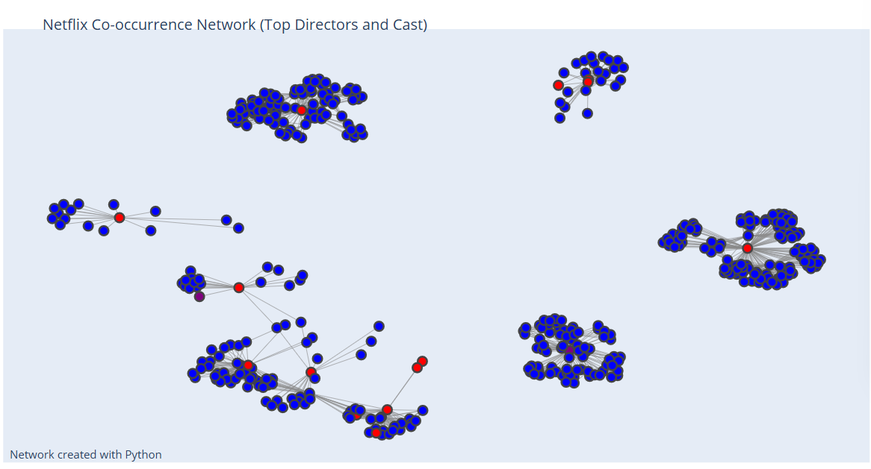
Network graph
How is this made?

Slide 6
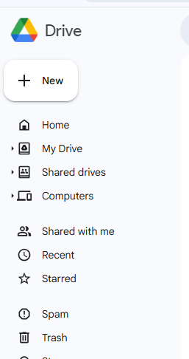
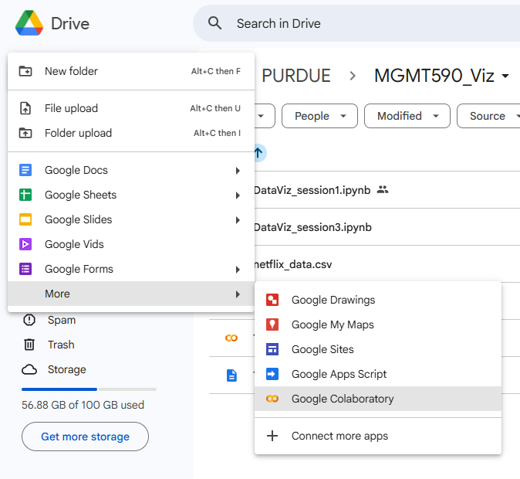



Preparation: First things first
Open a new blank Colab Notebook

Slide 7
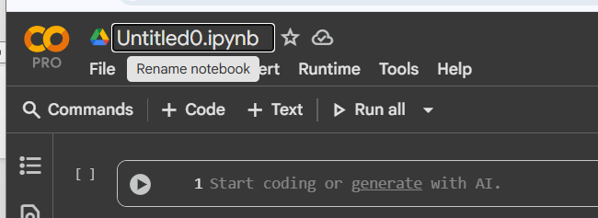
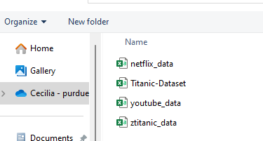
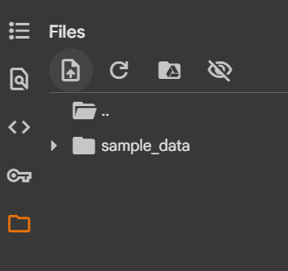
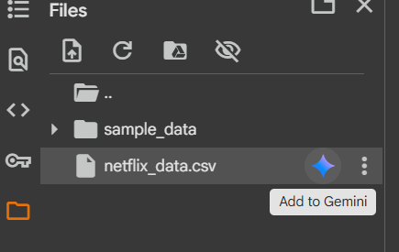








Preparation: Step 2
Rename Notebook & Load Data

Slide 8
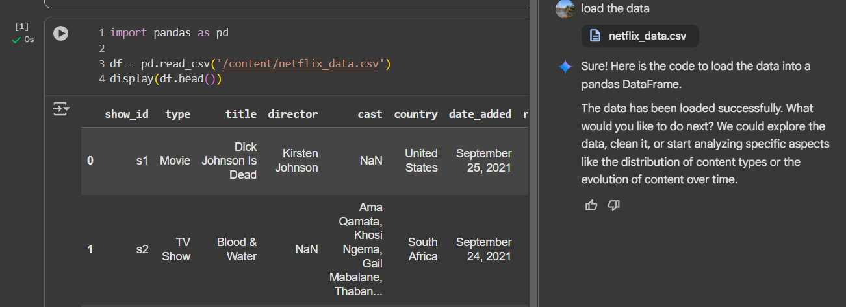
Step 1: Loading the data
Here’s how it should look

Slide 9
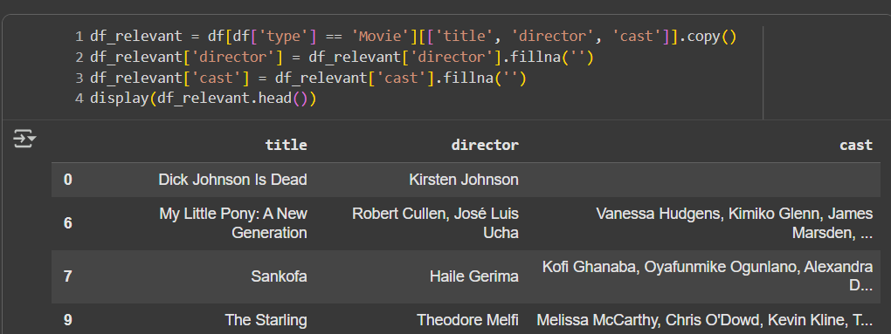
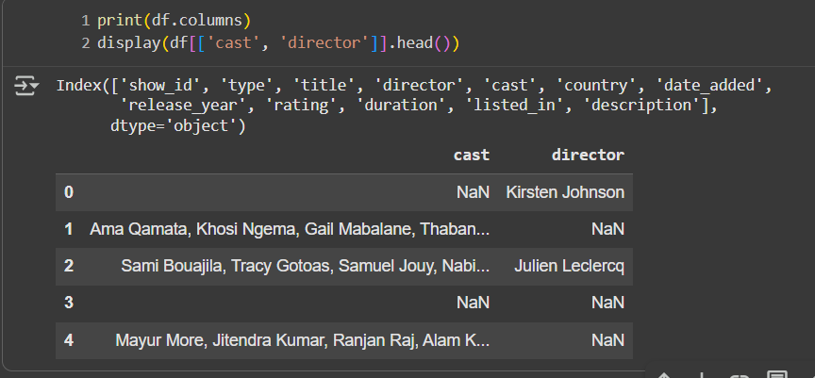
Step 2: Inspect the data
What is relevant?
If we are interested in the network of who is working with whom, then ‘cast’ and ‘director’ would be the two features we are interested in

Slide 10
Step 2.1: Trim the data
What is relevant?
Trim down the dataset to work only with the features we care about
Faster and easier to process

Slide 11
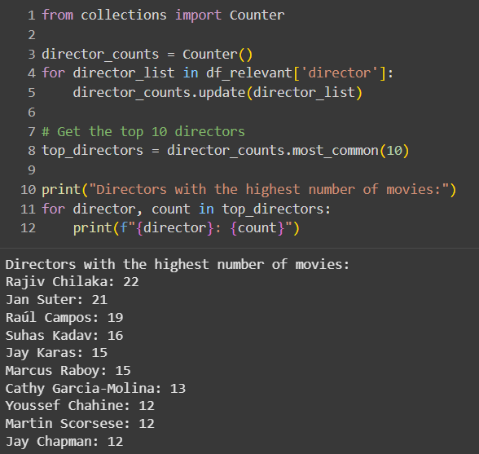
Step 2.2: Inspect features specific to what we want
Directors: highest number of movies?
What other statistics or information would we want to know?
Is it available from the current dataset?
If not, where can we find that information?
Other information that might be useful?
What we if filter for only most recent movies from the last 5 years?
Does that change our “big idea” / insight?

Slide 12
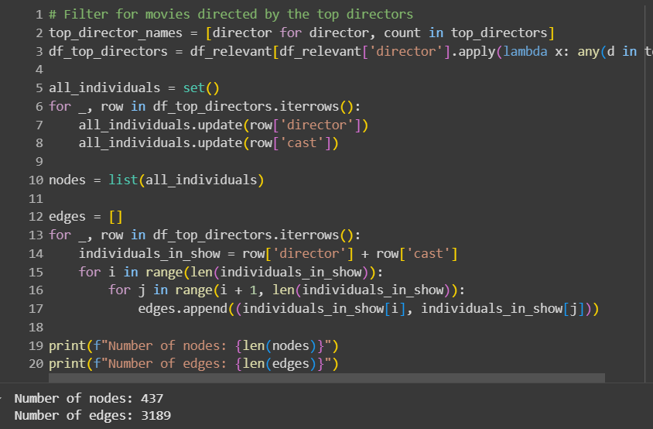
Step 3: Visualization
Network graph of who’s working with whom
Individual cast and directors as nodes
If they worked together on the same show or movie, then they will be connected via edges
My design choice:
Filtered by “top 10” director based on the number of movies included in the dataset
Other design choices:
No filtered
Include cast and directors from both movies and tv shows
Filter for recent works only
Many, many, MANY other choices you can make

Slide 13
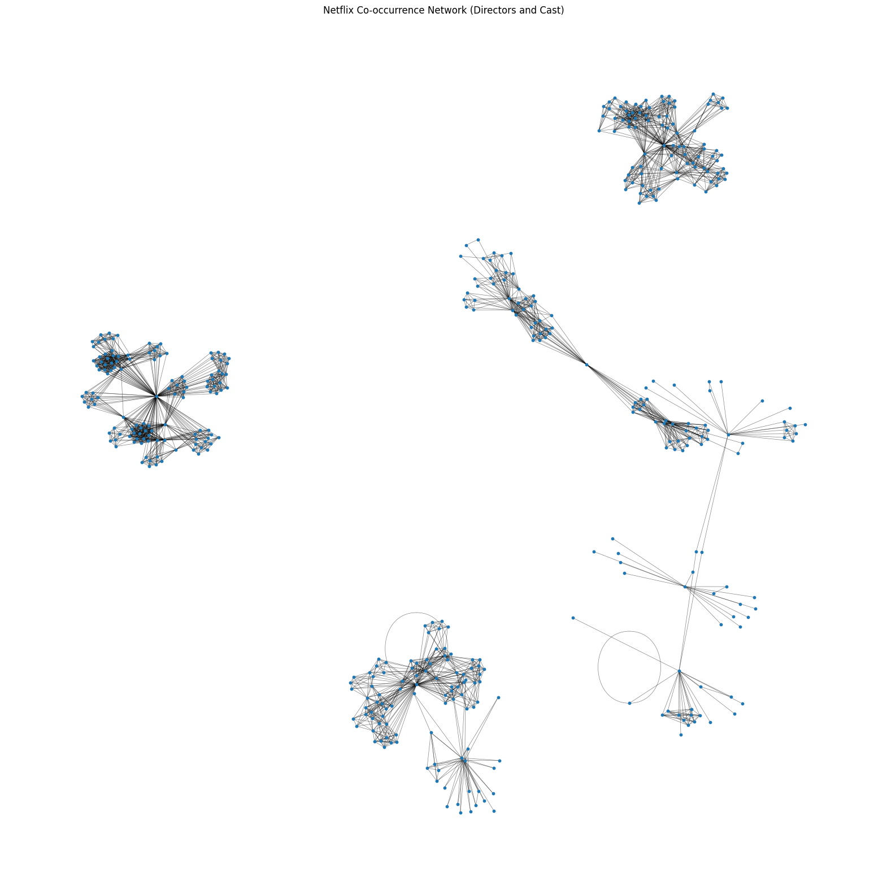
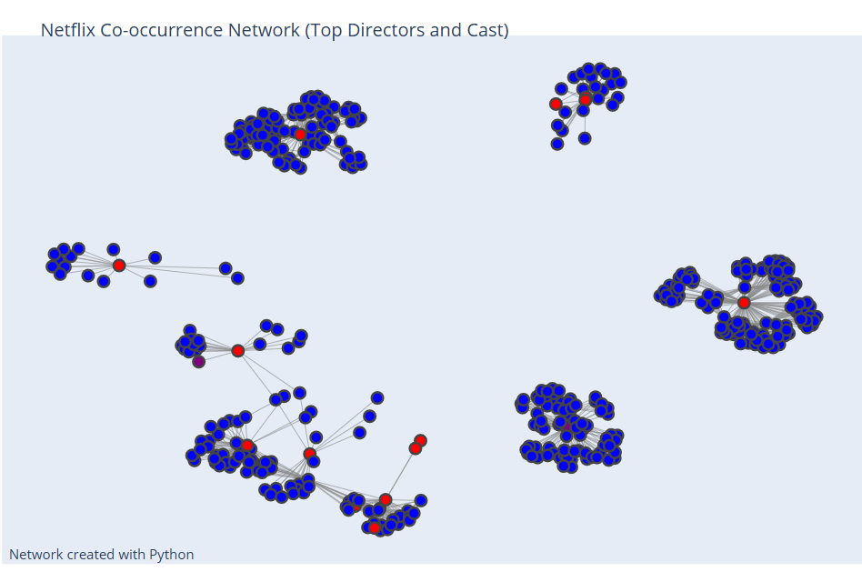
Step 3.1: Design of the visual
Dealer’s choice at this point…
Matplotlib
Plotly

Slide 14


Game on… GAME 2!!!
Go to https://kahoot.it/ or open the Kahoot mobile app and tap Join
Enter the game PIN
Enter your name and join

Slide 15
Hands-on Practice
Getting Started with Power BI

Slide 16
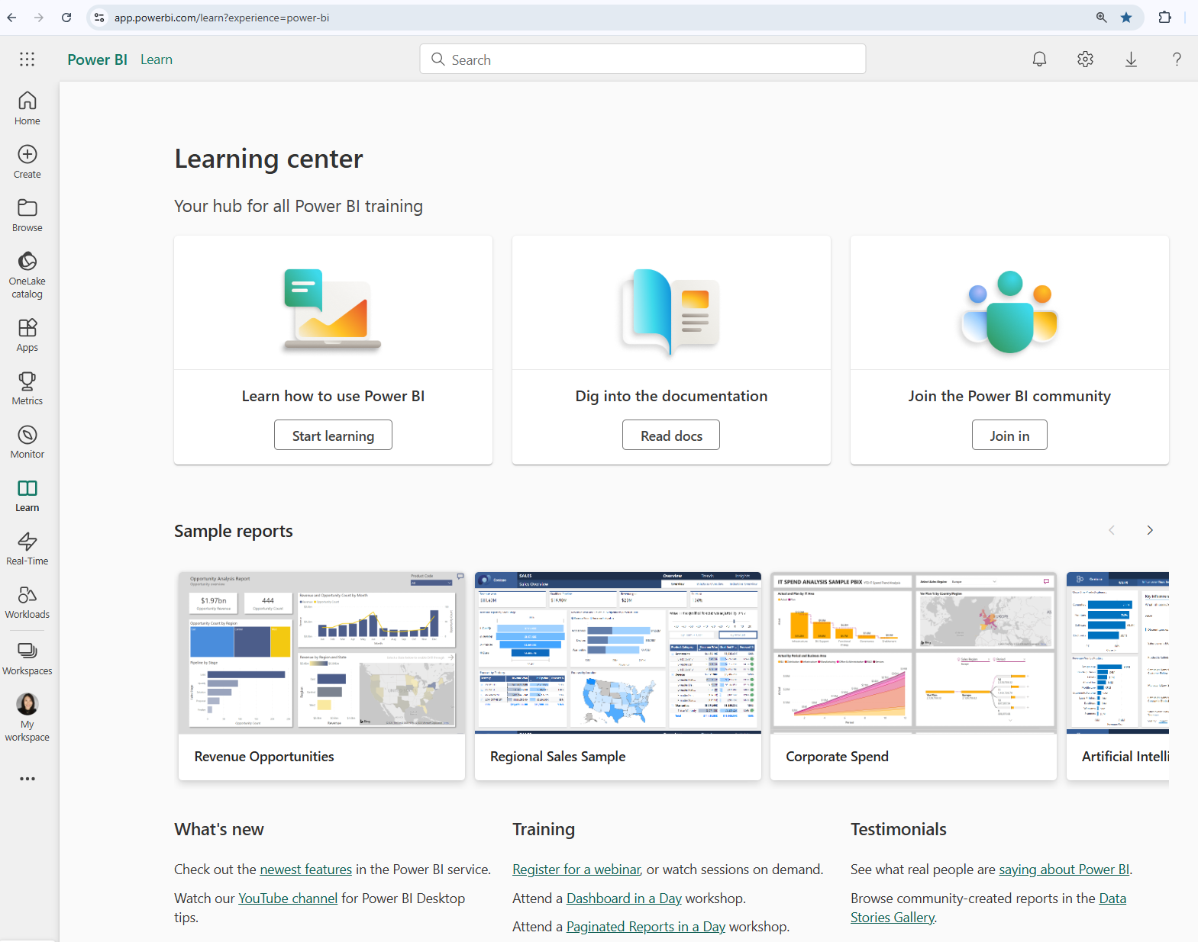
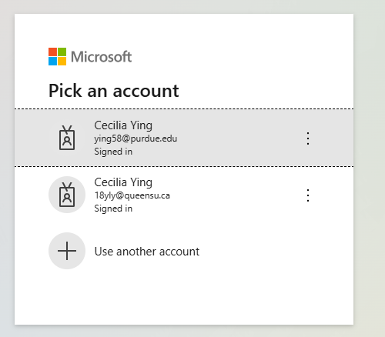
Account Setup & Sign in
Purdue emails
https://app.powerbi.com/learn?experience=power-bi

Slide 17
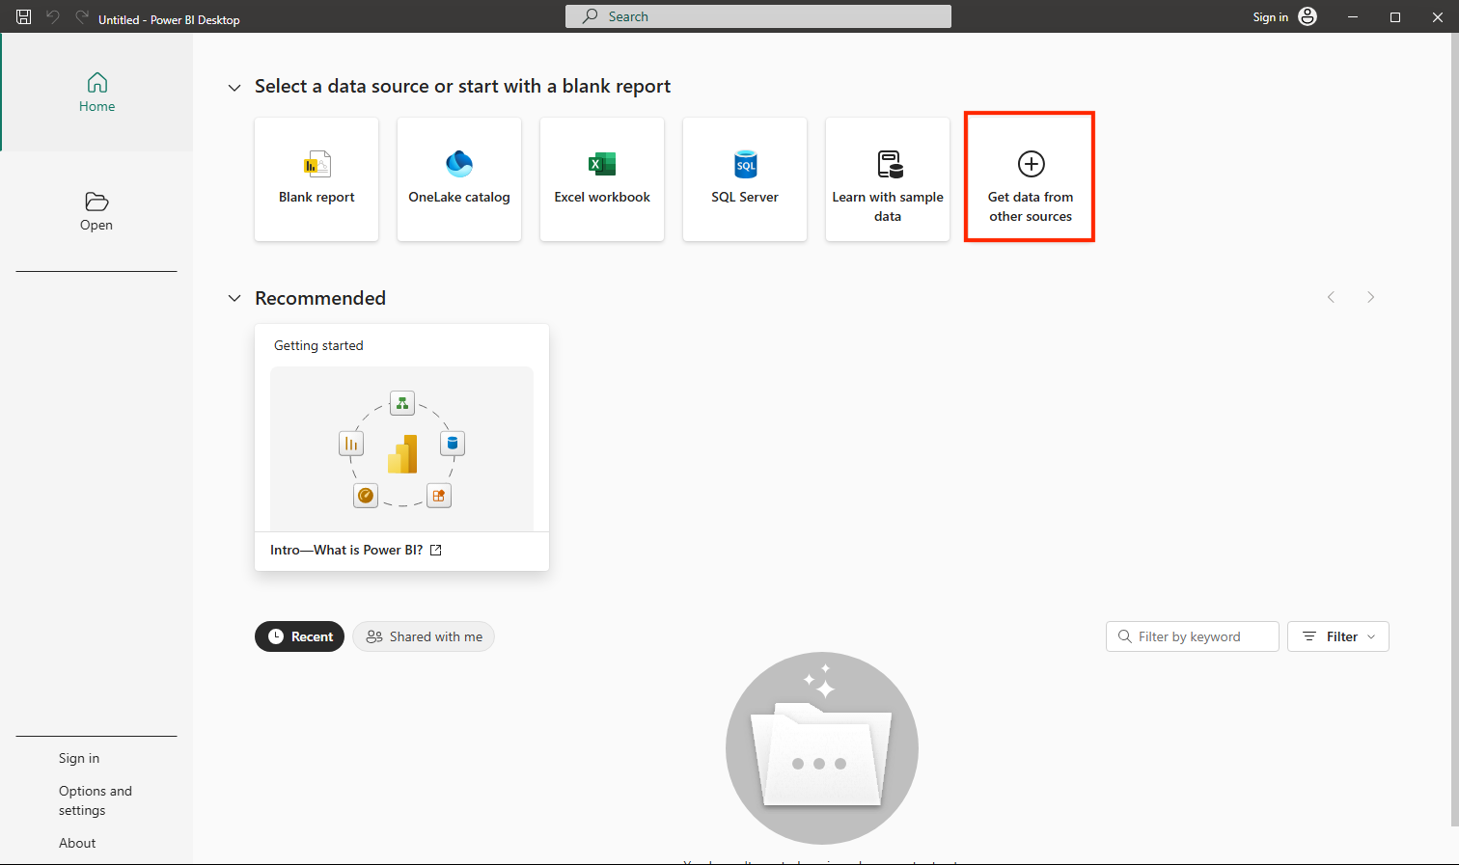
Power BI 101 – Explore Fundamentals of Data Visualization
https://microsoftlearning.github.io/DP-900T00A-Azure-Data-Fundamentals/Instructions/Labs/dp900-pbi-06-lab.html

Slide 18

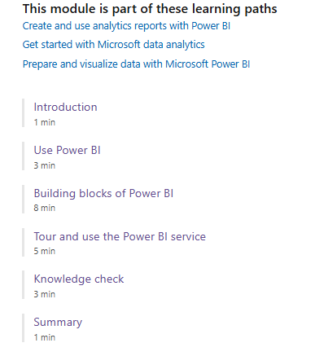
Building with Power BI
https://learn.microsoft.com/en-us/training/modules/get-started-with-power-bi/

Slide 19
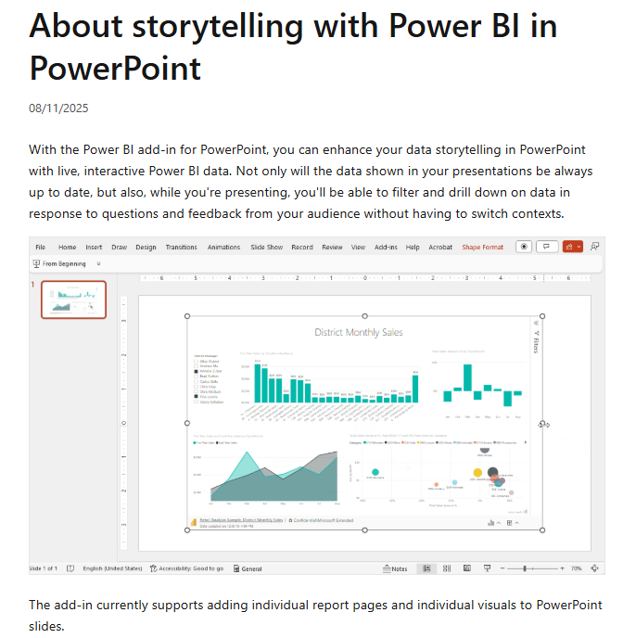
Storytelling with Power BI in PowerPoint
https://learn.microsoft.com/en-us/power-bi/collaborate-share/service-power-bi-powerpoint-add-in-about

Slide 20
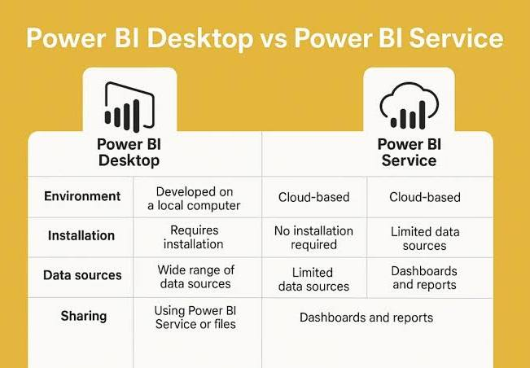
Power BI Service (web) vs. Desktop
Two different options
Desktop:
For building the visualization
Service:
Can also create reports
More for sharing and viewing

Slide 21
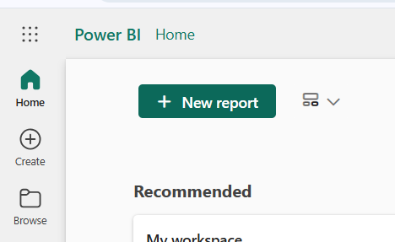
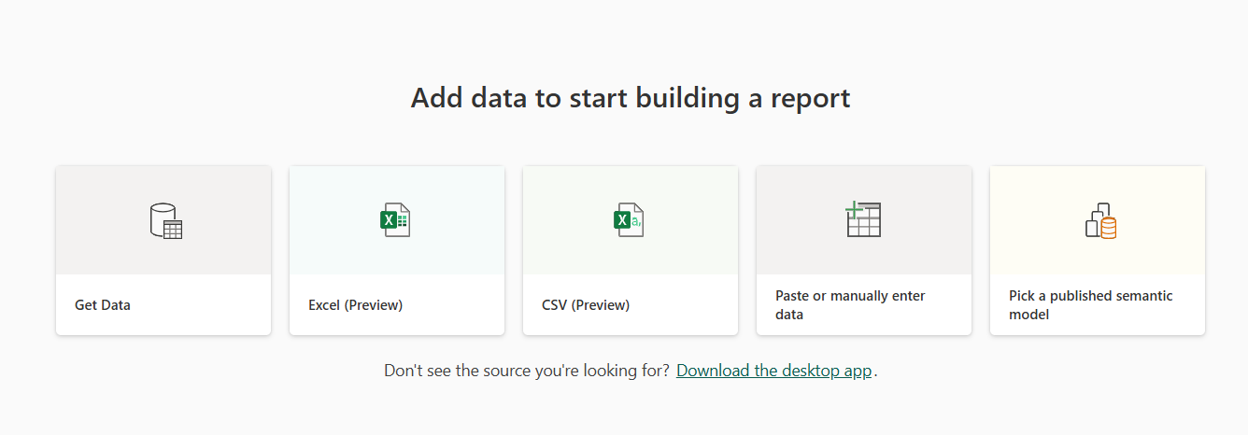




Step 1: Ways to load the data
From “Home”
Different ways to load your data
Supports different formats
Supports different channels (upload a file directly, connect through a URL or database, etc.)

Slide 22
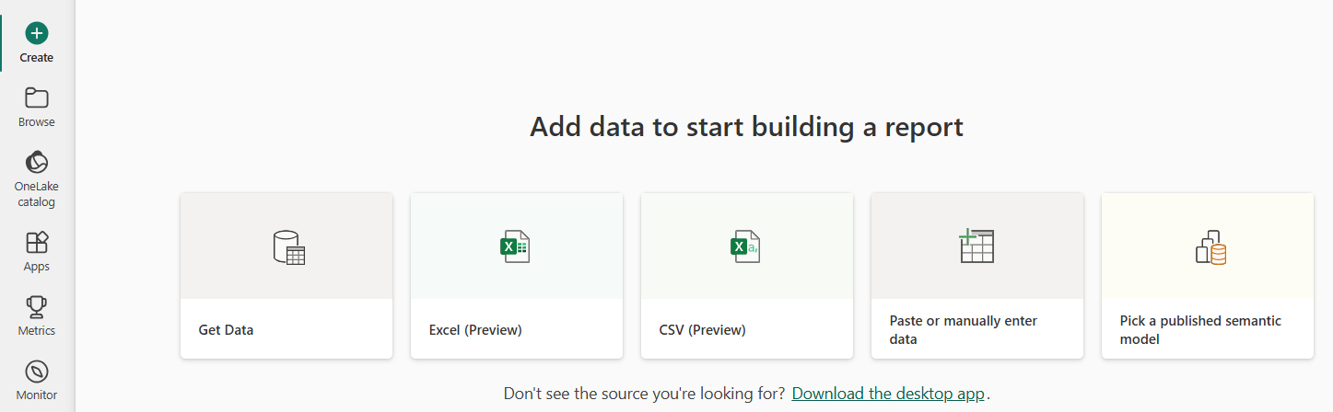
Load data from “Create”

Slide 23
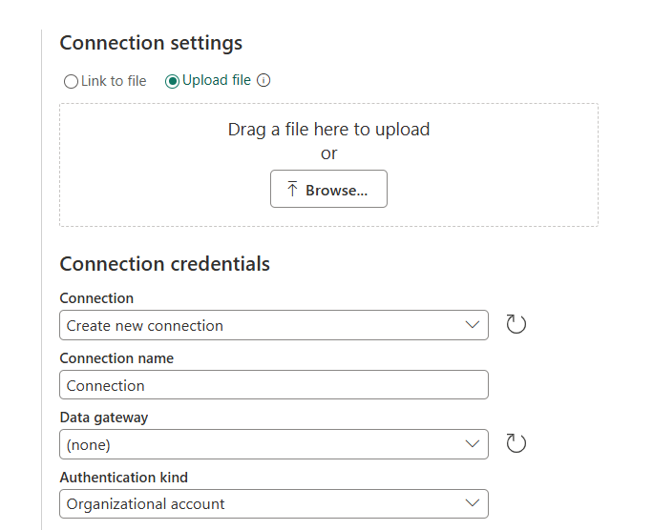
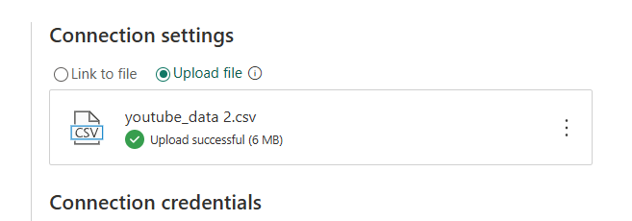







Step 1.1: Upload a csv

Slide 24
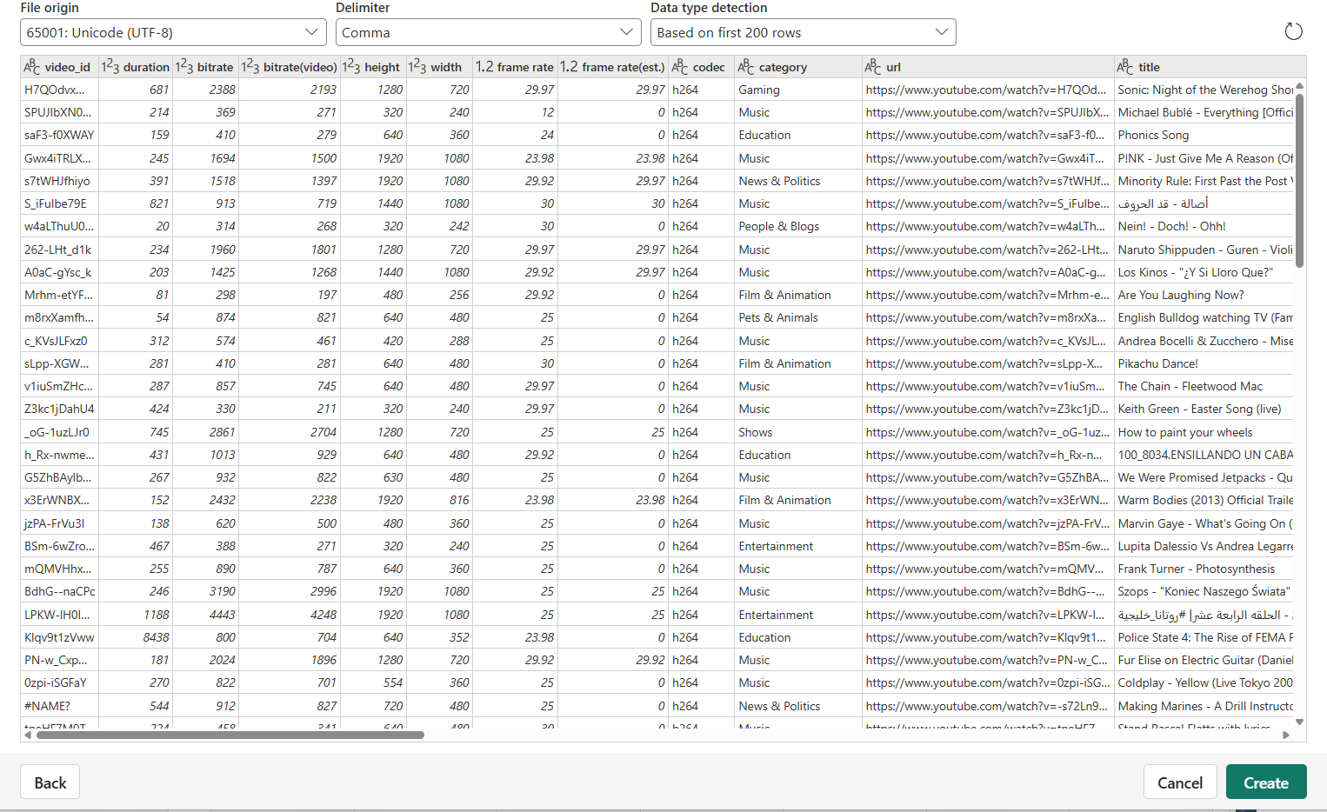
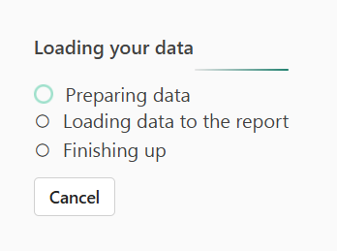
Step 1.2: Inspect the data

Slide 25
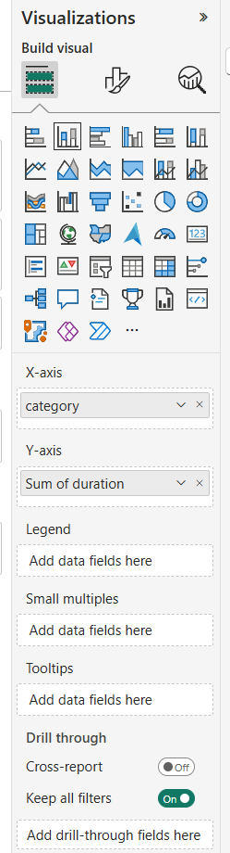
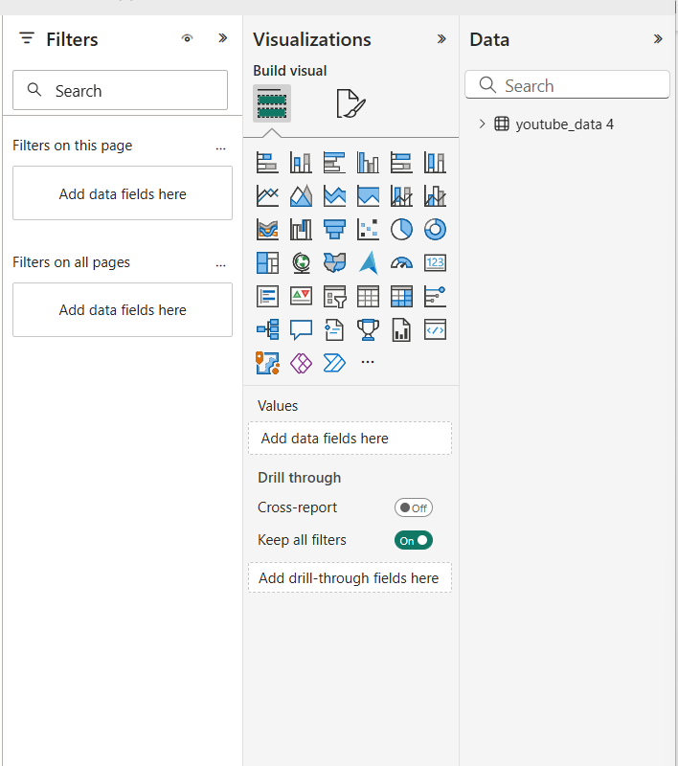
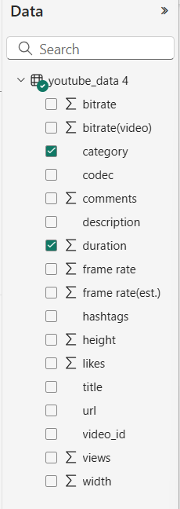
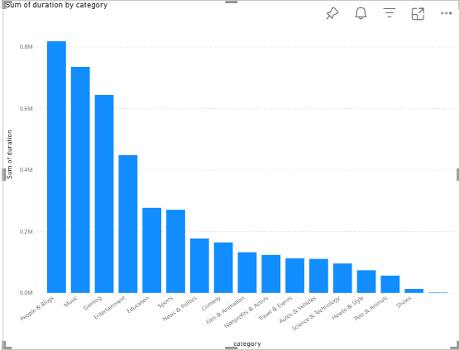


Step 2: Building your first report
Data, Visualizations, Filters
Start building your first report with the YouTube data
Data tab: Select “category” and “duration”
Visualization tab: Select “stacked column chart”

Slide 26
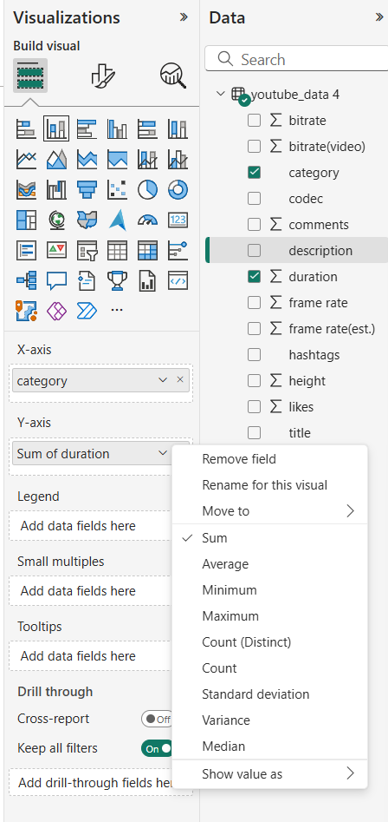
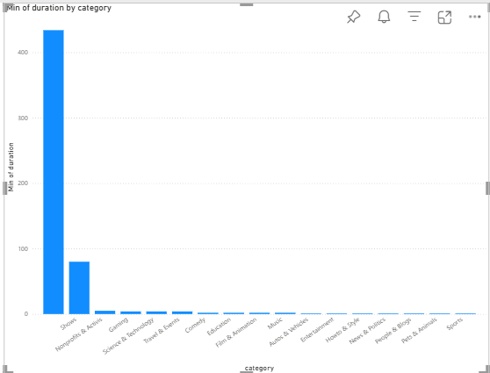


Step 2.1: Aggregated to non-aggregated
Sum of duration -> maximum
Your graph should change from this to that.
Value for “duration” is defaulted to be “sum of duration”
Assumed to be the most common aggregated form to be included in reports for something like duration
You can change it to another form of aggregated value like
Average
Count
Or a non-aggregated value like
Minimum
Maximum
Click on the dropdown arrow of the variable you want to change “sum” to “minimum”
What do we change it to if we want to see how many videos are in each category?

Slide 27
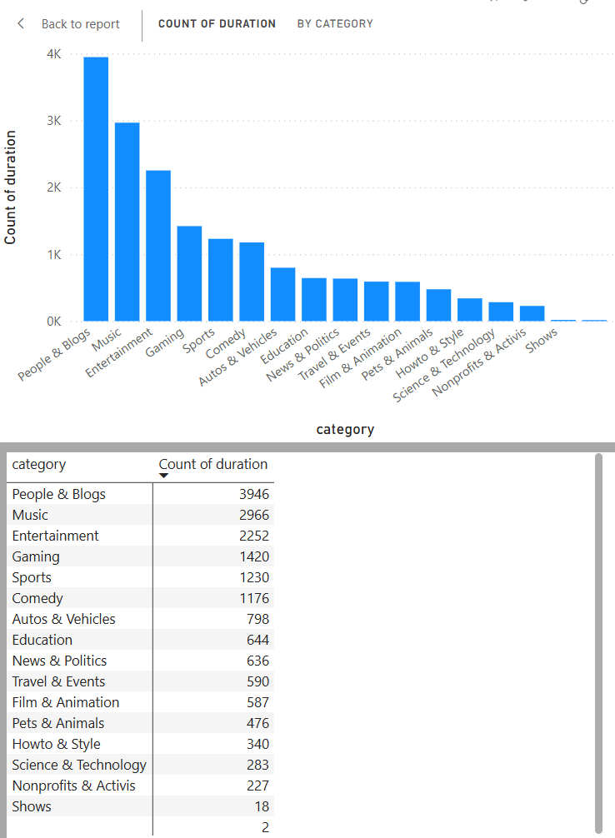
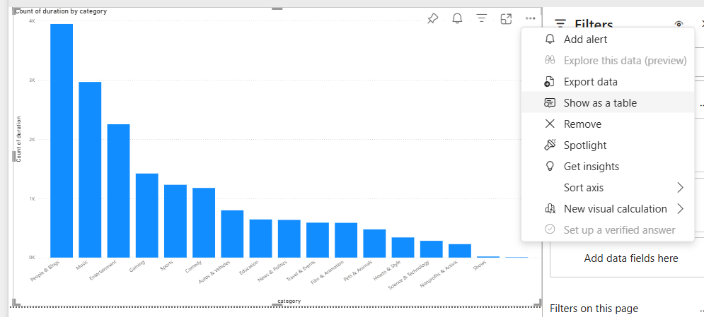


Exercise: How many videos per category?

Slide 28
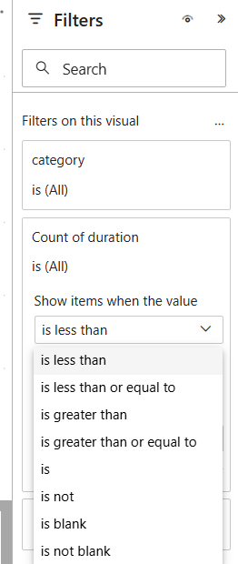
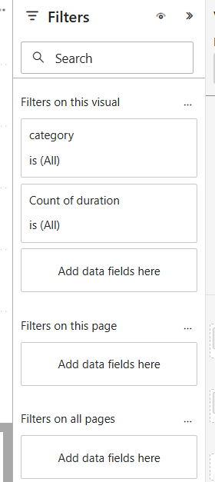
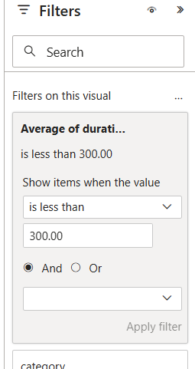
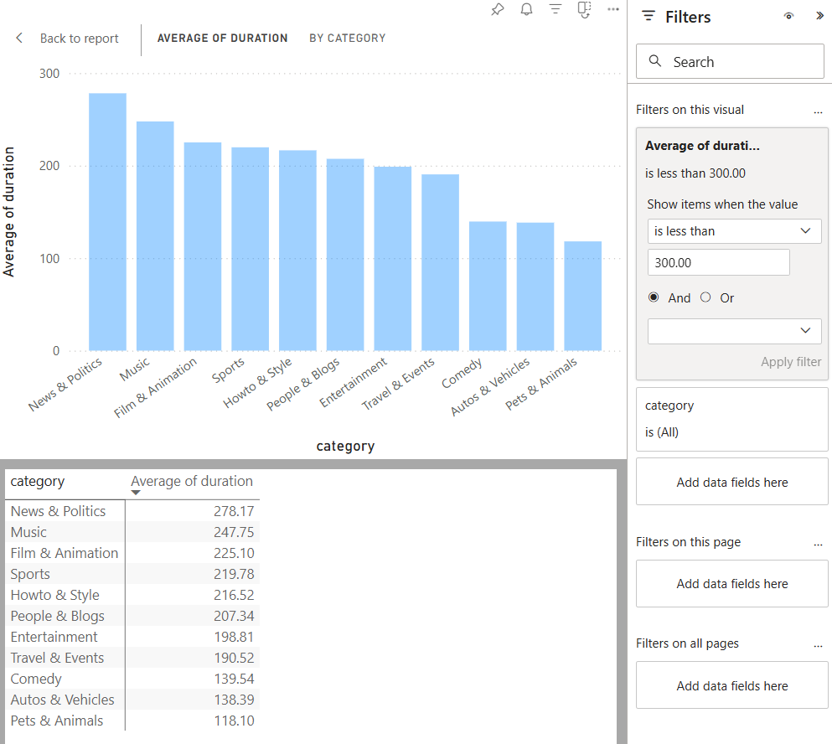



Step 2.2: Filter
Filter for only short videos
How do we filter for videos that are less than 5 minutes?

Slide 29
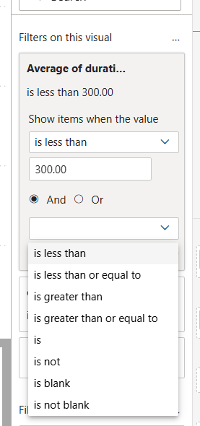
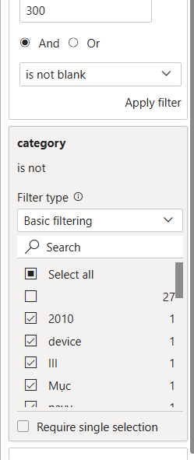
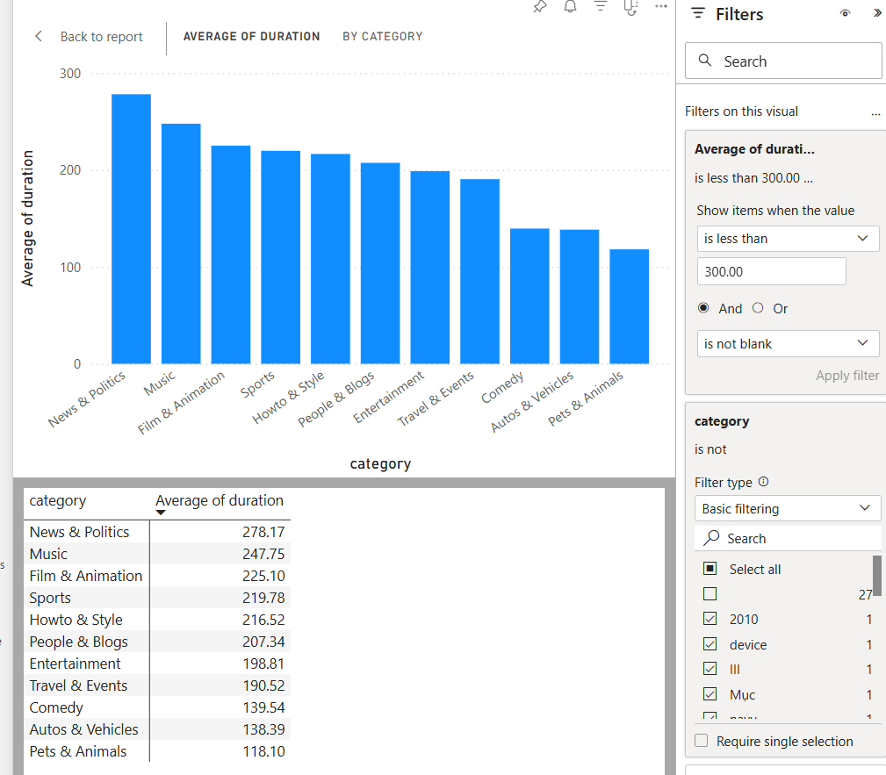


Step 2.2: Filter
Addressing missing data by removing it from our visual
Exclude null/ missing values

Slide 30

That’s a wrap

Slide 31
Assignment 2
Crafting and articulating that Compelling Story

Slide 32
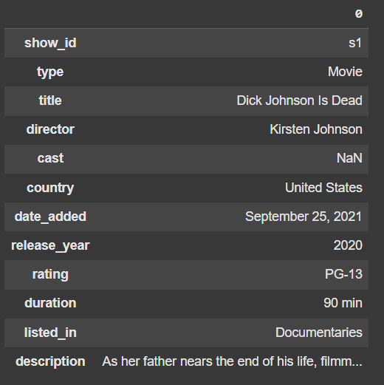
Dataset
https://www.kaggle.com/datasets/shivamb/netflix-shows
About this Dataset: Netflix is one of the most popular media and video streaming platforms. They have over 8000 movies or TV shows available on their platform. As of mid-2021, they have over 200 million subscribers globally.
This tabular dataset consists of listings of all the movies and TV shows available on Netflix, along with details such as cast, directors, ratings, release year, duration, etc.

Slide 33
Context
Counter the threat of GenAI-generated movies: a study of Rajiv Chilaka vs. Martin Scorsese
You have been hired by a cool animation startup in LA to draw insights from the works of Rajiv Chilaka and Martin Scorsese based on the data available in this dataset.
You will then use these insights to recommend strategies for them to counter the threat of GenAI-generated movies.

Slide 34

Rajiv Chilaka
Highest number of directed movies in the dataset
Rajiv Chilaka is an Indian animation filmmaker known for his work on shows like “Chhota Bheem” and “KikoRiki”.

Slide 35

Martin Scorsese
You know… the guy who directed Goodfellas, The Departed, The Irishman, etc.
Martin Scorsese is an American film director known for his gritty, intense films like “Goodfellas”, “The Departed”, and “The Irishman”.

Slide 36
Deliverables
Executive Summary & Supporting Analysis
A one-page executive summary detailing the analysis, insights, and recommendations.
One killer figure.
Additional supporting analysis can be included as an appendix.

Slide 37
Grading Criteria
How well can you craft and articulate the story
Crafting the Compelling Story (50%)
Depth and relevance of insights drawn from the data analysis
Articulating the Compelling Story (50%)
Clarity, coherence, and organization of the executive summary
Effectiveness of recommendations for countering GenAI threats
Originality and creativity of the approach
Ability to identify and leverage key relationships, trends and patterns in the data
Use of effective visualizations to support findings and recommendations
Ability to communicate complex ideas and insights in a clear and concise manner

Slide 38
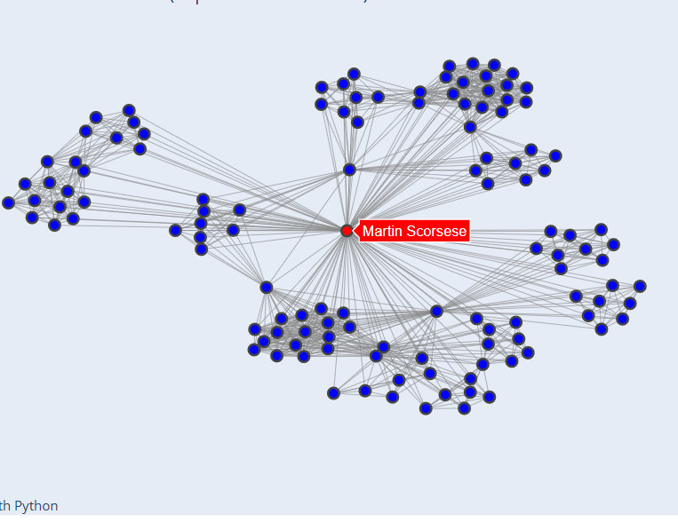
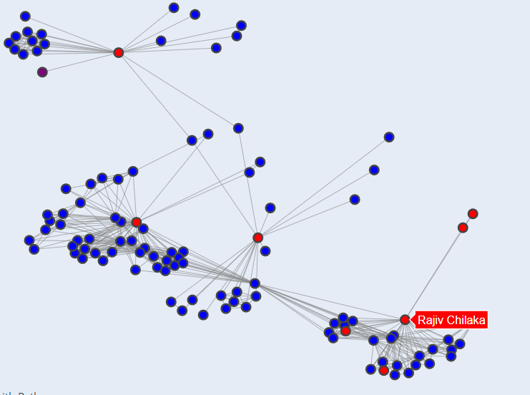
Network analysis
Who are these guys working with?
More on this next week

Slide 39
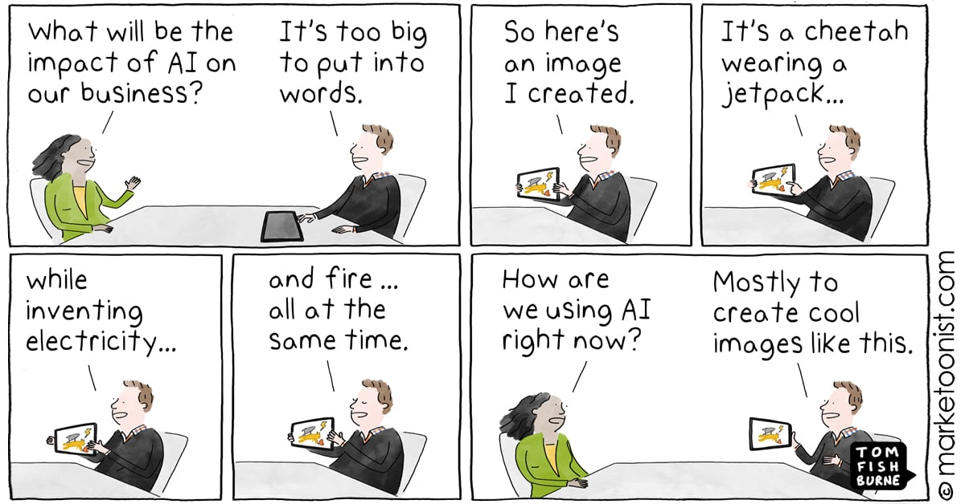

Slide 40
Team Project
Building your “killer figure”

Slide 41
Team Project Description
Building your “killer figure”
Context
You are pitching a business case to a group of senior technology executives at your company, but a call came in, and the CTO will have to leave the meeting in 5 minutes.

Slide 42
Team Project Description
Building your “killer figure”
Challenge
You have 5 minutes to summarize your key findings, assumptions, and/or projections to convince your CTO that YOUR project is worth funding.

Slide 43

Ryan Buell’s famous “Killer Figure”
Professor from Harvard Business School https://www.hbs.edu/faculty/Pages/profile.aspx?facId=320524
“You should be able to summarize your entire presentation using ONE KILLER FIGURE.”

Slide 44
Team Project Description
Building your “killer figure”
Your Tasks
Identify a domain that is interesting to your team.
Find a dataset in that domain (common places to look: HuggingFace, Kaggle, UCI, Papers with Code)
Craft a project idea based on the data you are using (more on the next slide)
Create one killer figure that clearly tells your story
5-minute in-class presentation using the killer figure

Slide 45
Team Project Description
Building your “killer figure”
Project Objectives
Crafting a compelling story with data
Clearly articulate that story with one killer figure
Be creative and have fun

Slide 46
Team Project Description
Building your “killer figure”
Crafting Your Idea
What problems are you trying to solve?
What questions are you trying to answer?
What kind of data will you need?

Slide 47
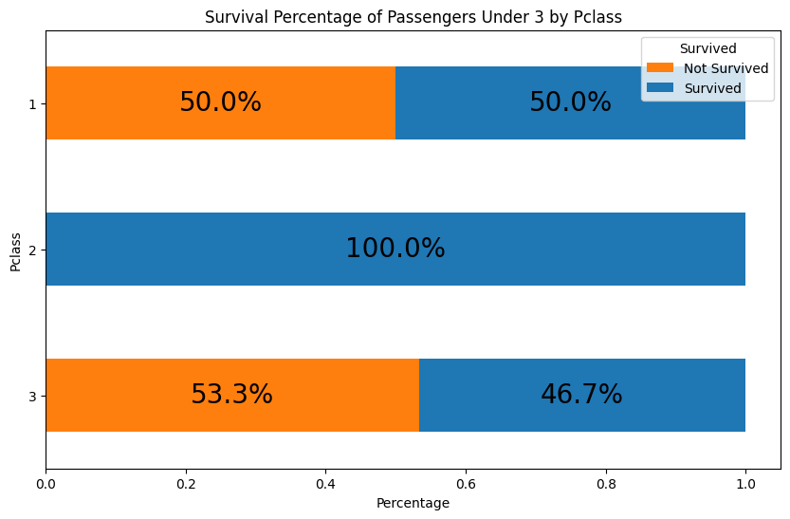
Team Project Description
Building your “killer figure”
Punchline:
The first-class children have only a slightly higher survival percentage (50%) than the third-class children (46.7%)!

Slide 48
Team Project Description
Building your “killer figure”
The first-class children pay, on average $151, which is 6 times higher than third-class children, who pay, on average $23. And yet, the company failed to ensure their safety.
Business proposal to
Improve the overall survival percentage for all children.

Slide 49
Team Project Description
Building your “killer figure”
Watch this video for inspiration (as needed)
How Consulting Firms Make Complex Topics Simple
Analyst Academy

Slide 50
Common Data Sources
Some recommendations
Huggingface: https://huggingface.co/docs/datasets/en/index
Kaggle: https://www.kaggle.com/datasets (Here you will also easily find code/notebooks from others, but be careful when using someone else's code - it might take more time to debug than write your own)
UCI: https://archive.ics.uci.edu/datasets
Papers with code: https://paperswithcode.com/datasets (this one is great if you want to read the research that's been done on the particular dataset)

Slide 51
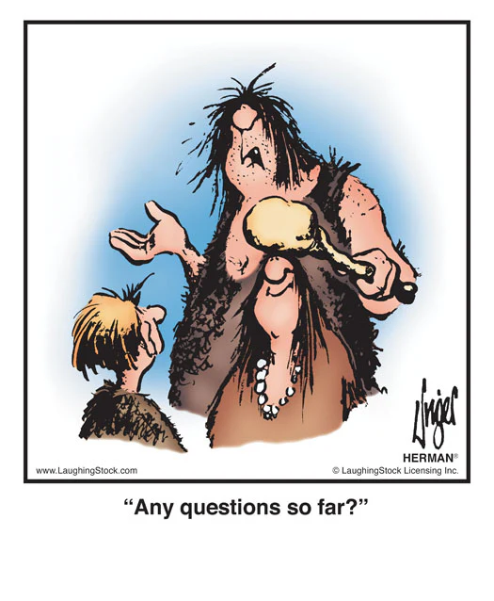
Questions?

Slide 52

Questions?

